Slide 1
PA week 8

Slide 2
Overview
Fit optimization
Features vs pressure

Slide 3

1. Modified equation
$$i_{piezo}\left(t\right)=A ∙ e^{\frac{−t}{τ}} ∙ \sin{(2π}ft+ϕ)+C+D.t$$
amplitude - decay term - oscillatory term – compensate for shift and drift

Slide 4
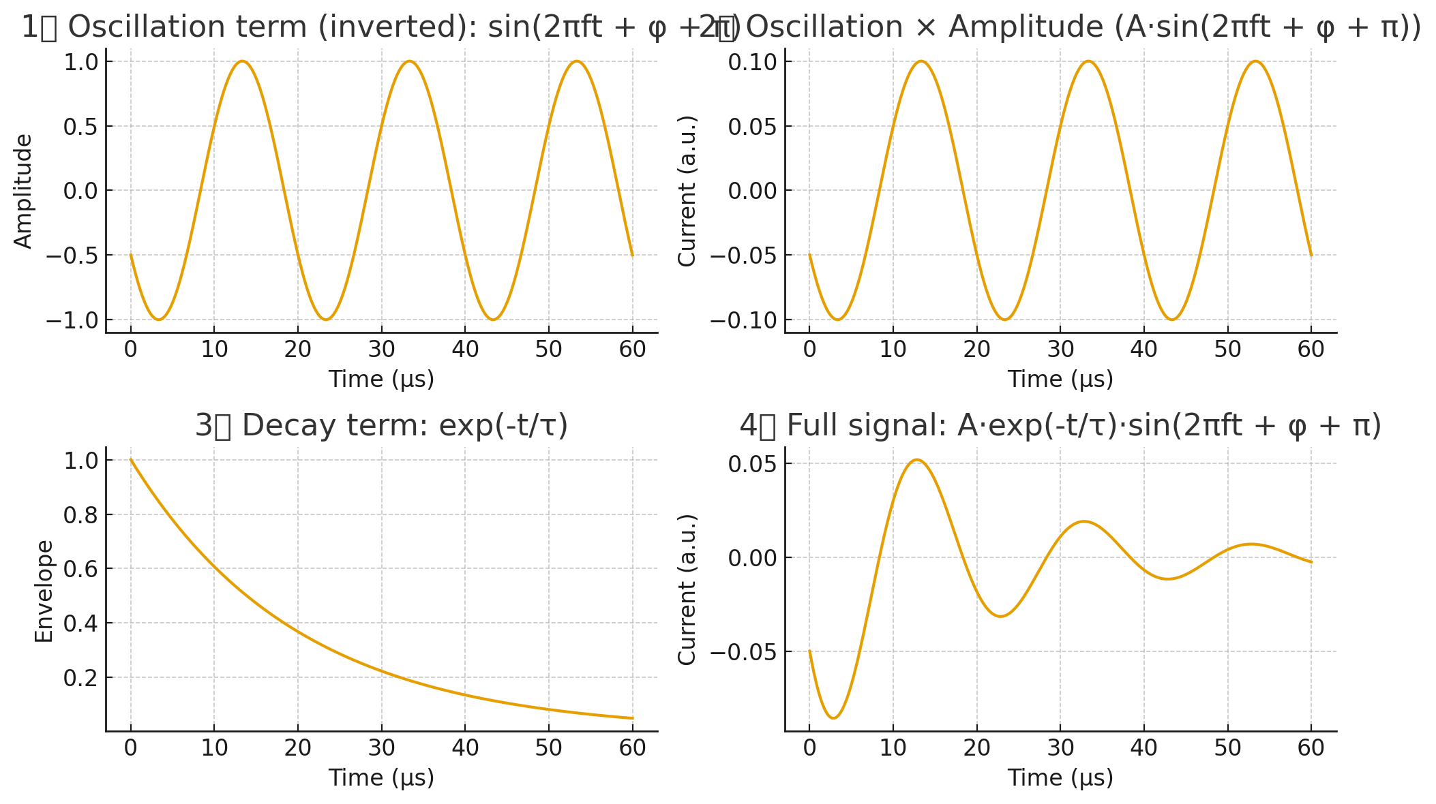
1. Modified equation

Slide 5
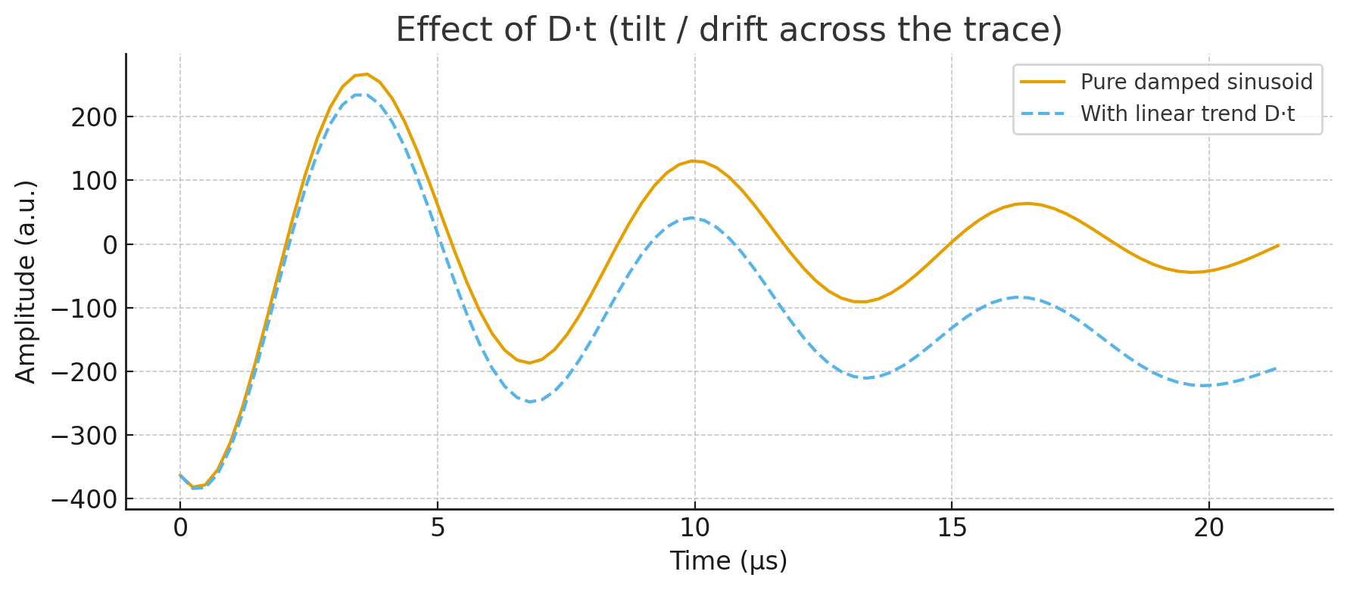
1. Modified equation

Slide 6
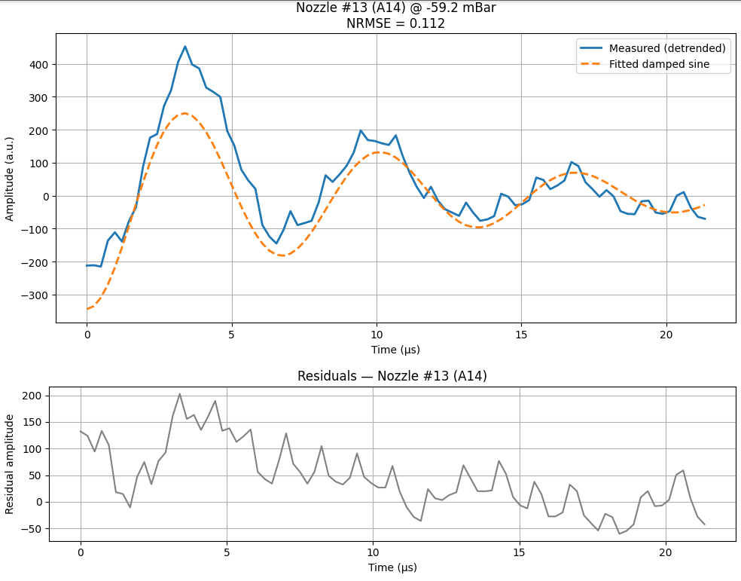
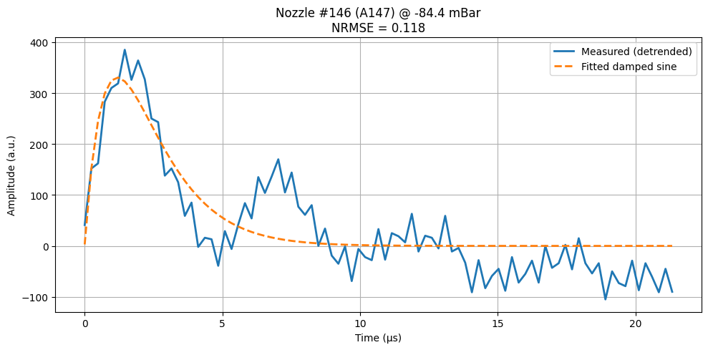
1. Modified equation

Slide 7
1. Parameters estimation
Step | Purpose | Method
Baseline (C, D) | Remove shift/drift | Linear regression
Frequency (f₀) | Estimate dominant oscillation | FFT
Amplitude (A₀) | Estimate oscillation strength | 0.7*range of detrended signal
Decay (τ₀) | Estimate damping rate | Log-envelope of peaks
Phase (φ₀) | Align sine to data | Slope-based phase

Slide 8


1. Fitting algorithm
Switched from:
Scipy.optimize.curve_fit
To:
Scipy.optimize.least_squares with loss = 'soft_l1'

Slide 9

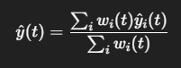
1. Windowed fitting
windows per signal of 89 samples
50% overlap
Distinct parameters for each window
Specified limits for parameter jumps form one window to the other
Weights = 1 / (NRMSE)^2

Slide 10
2. Features vs pressure
Notebook

